Slide 1

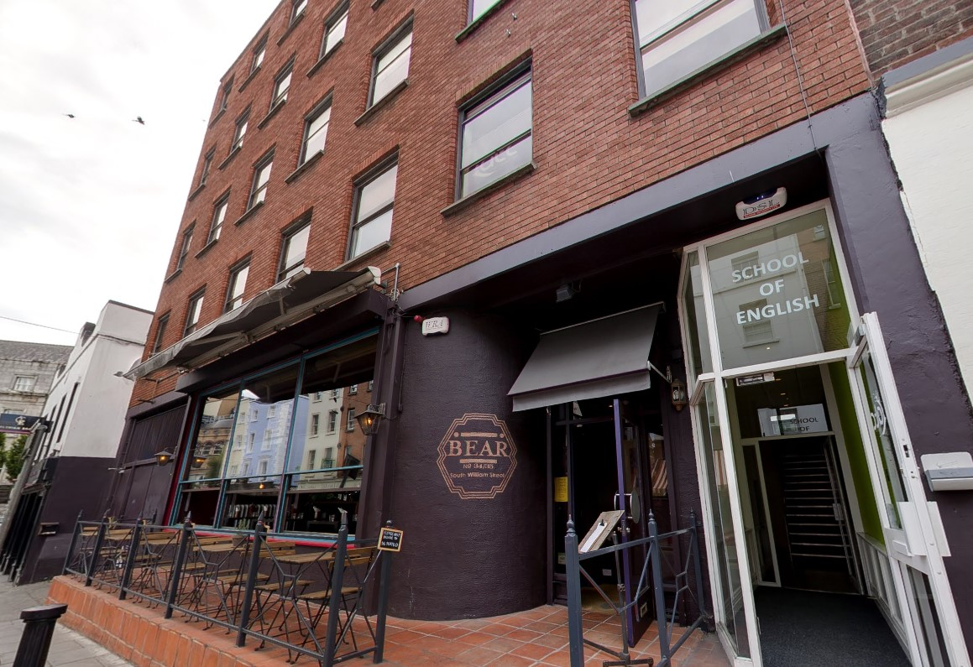
Language teaching
in the age of ai
19-23 august 2024
dublin

Slide 2
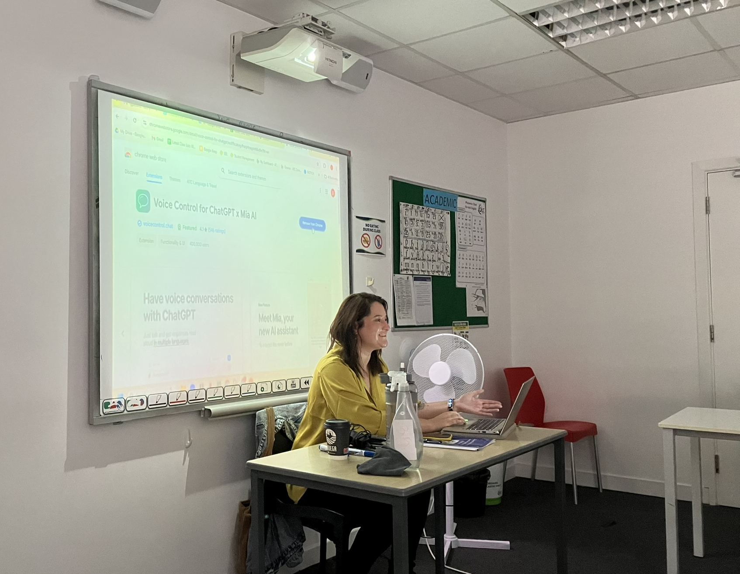
teacher

Slide 3
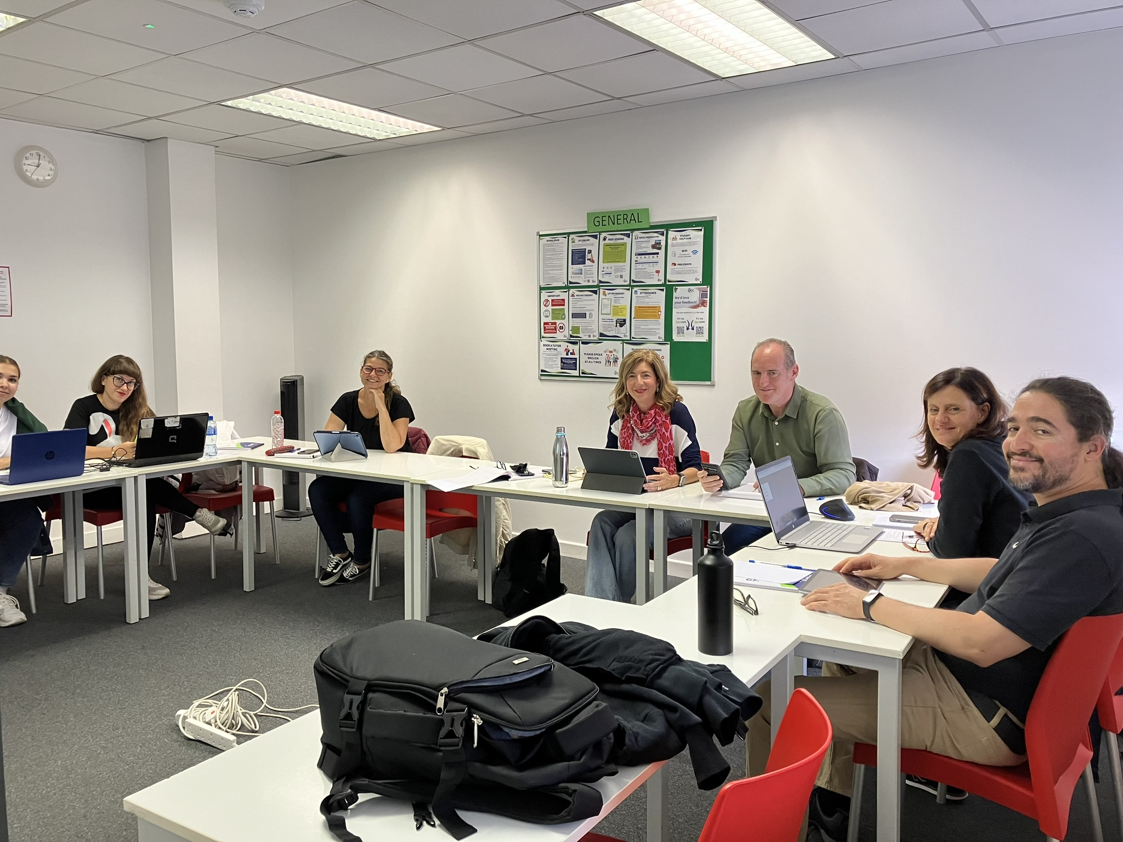
class

Slide 4
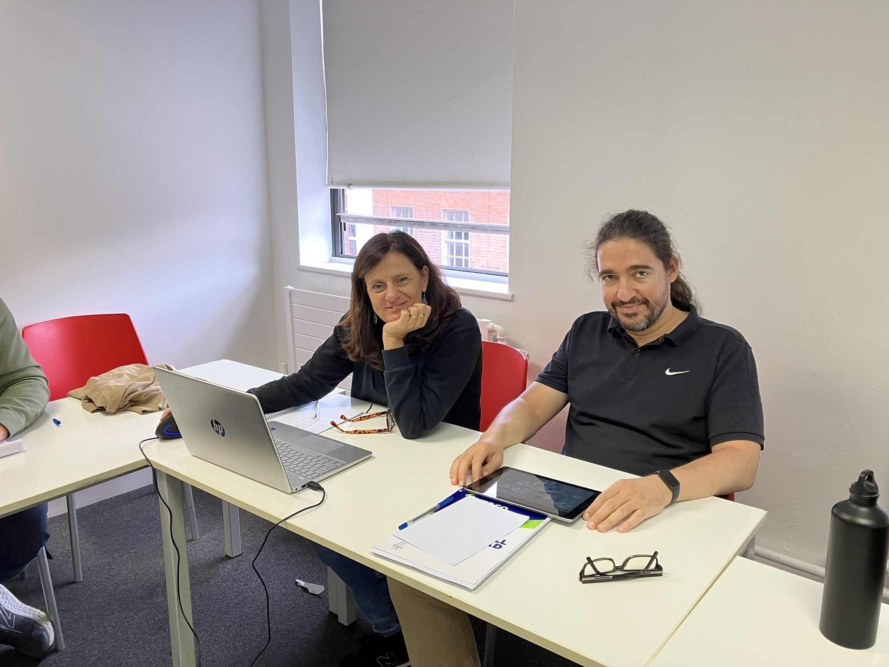
posing
H
h

Slide 5
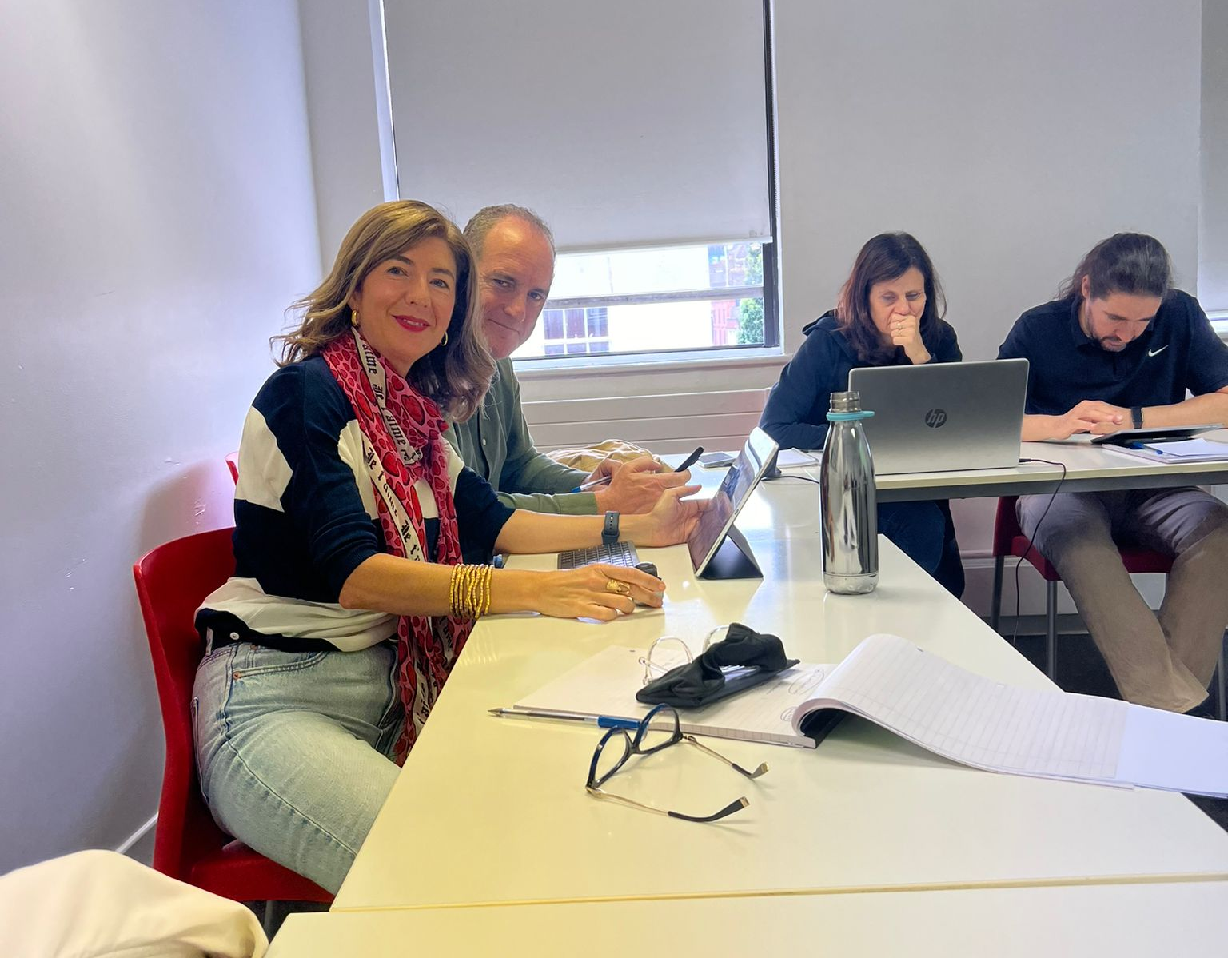
paparazzi
H
h

Slide 6
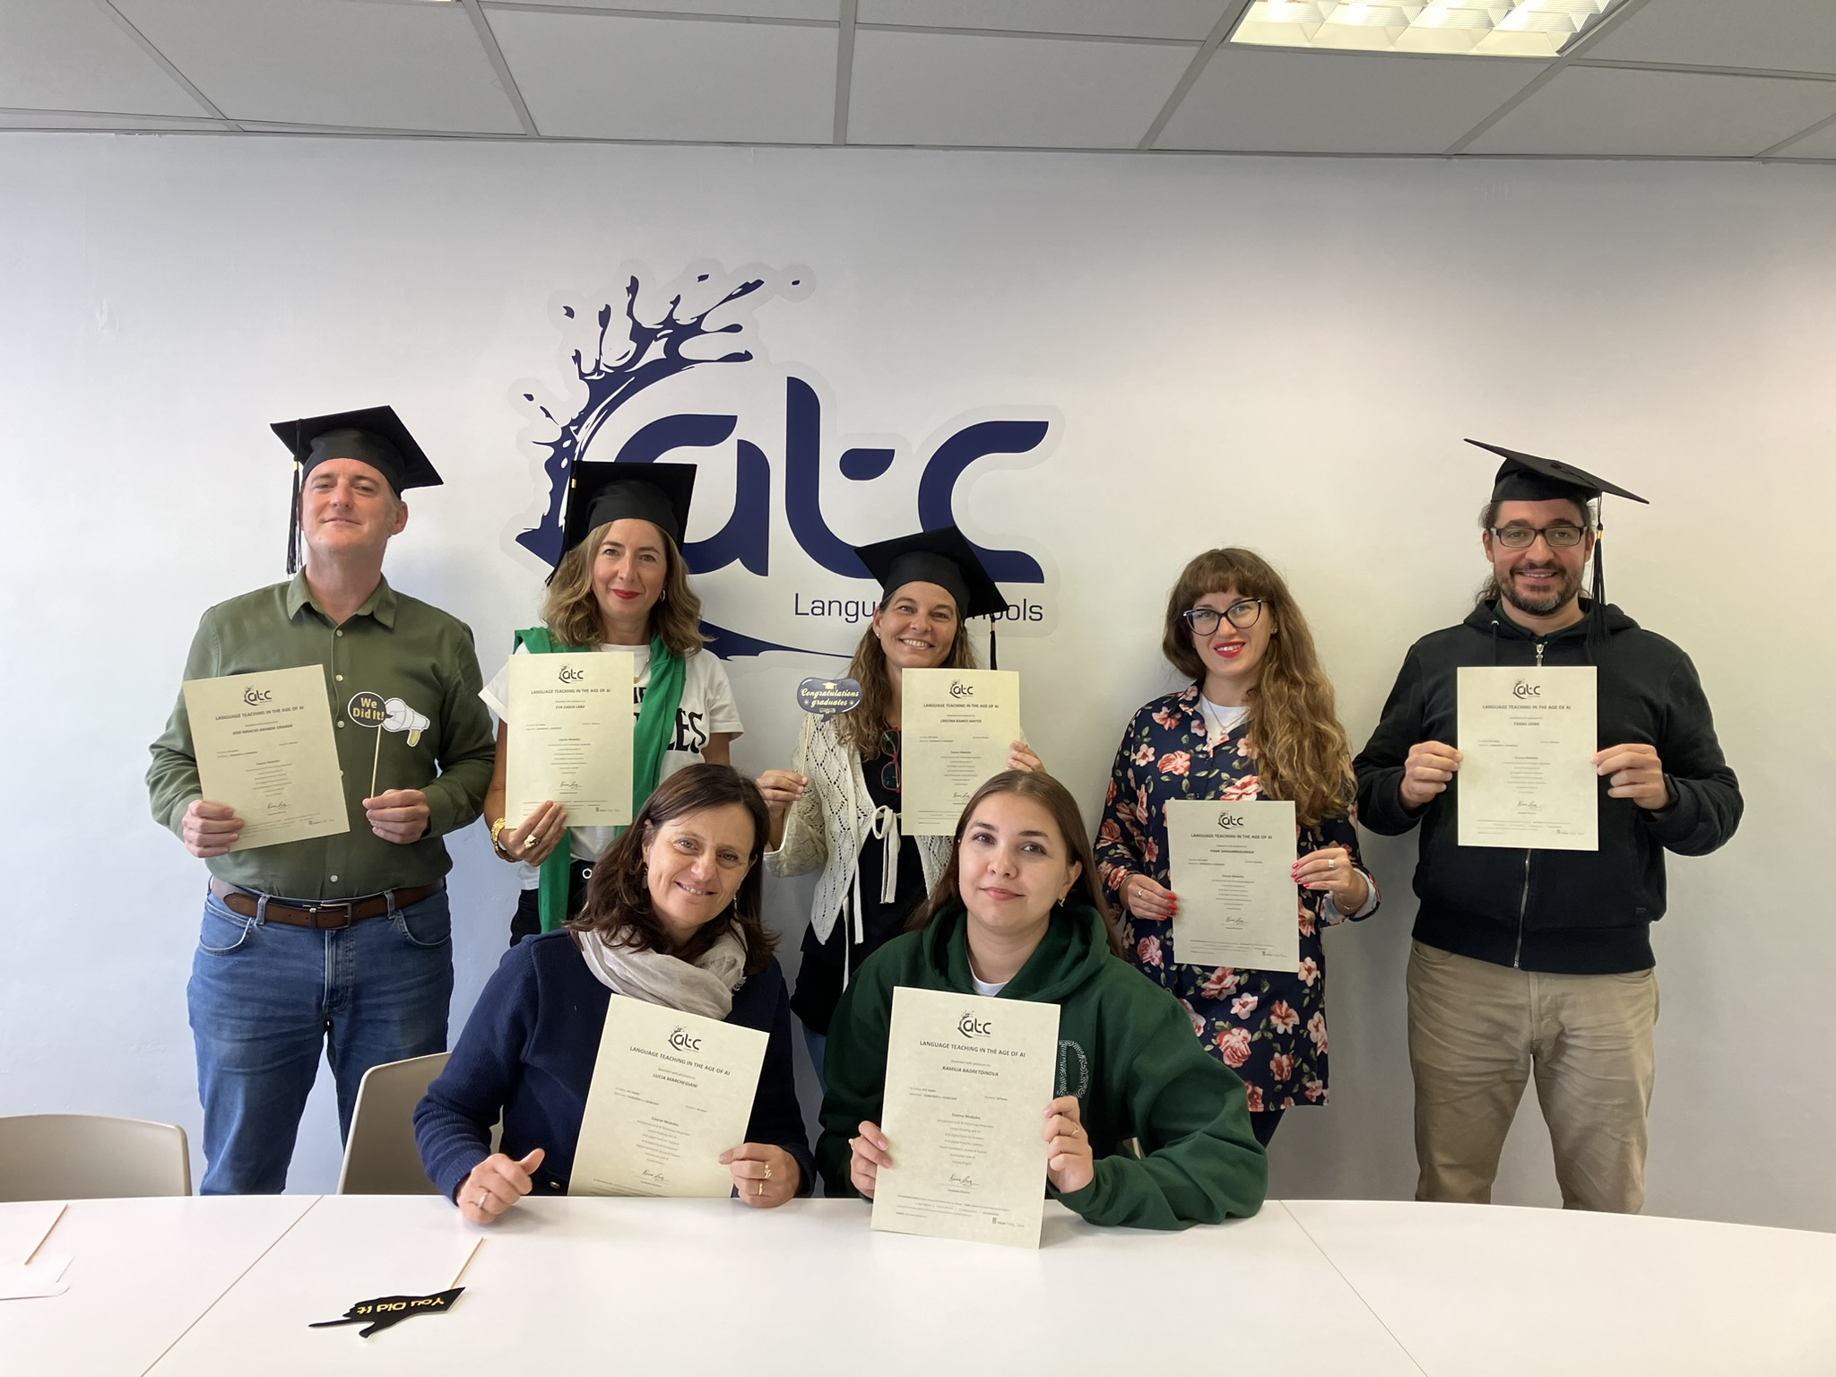
graduation

Slide 7
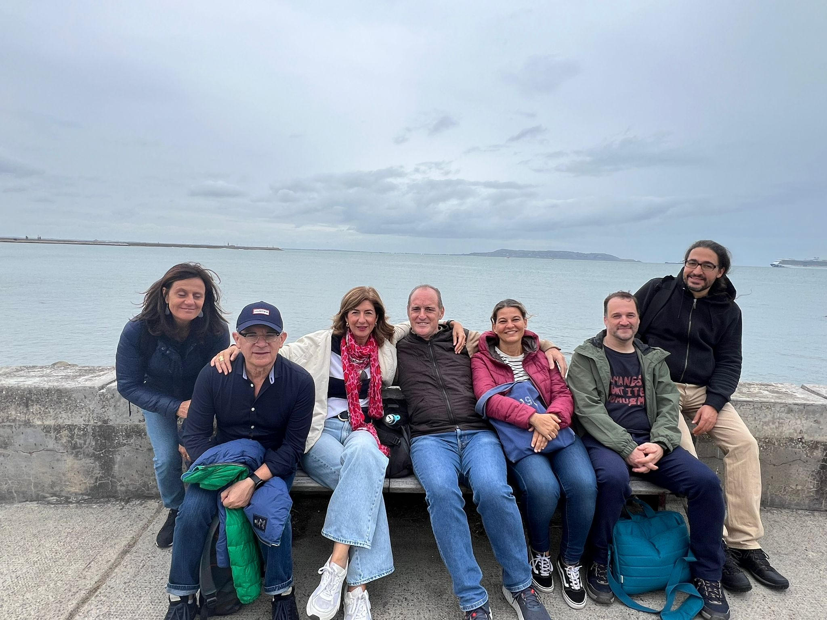
Free time
H
h

Slide 8

Ai chatbot for
various tasks

Slide 9

Making worksheets
for different learning levels

Slide 10

Various content
For language lessons

Slide 11

making voiceovers
from text

Slide 12
creating video content

Slide 13

Speaking to ai

Slide 14

educational platform for creating personalised learning materials

Slide 15
Interactive quiz platform

Slide 16
Study tool for creating flashcards

